Slide 1
Making art from birthdays
Short hands-on workshop to learn about generative systems
DesignUp 2017
Curtain Raiser Event
Rasagy Sharma
Designer, Mapbox

Slide 2
What will we do?
Use birthdays as our dataset: DD/MM/YYYY
Follow simple rules to use these to make something fun
Explore making our own rules (go crazy!)

Slide 3
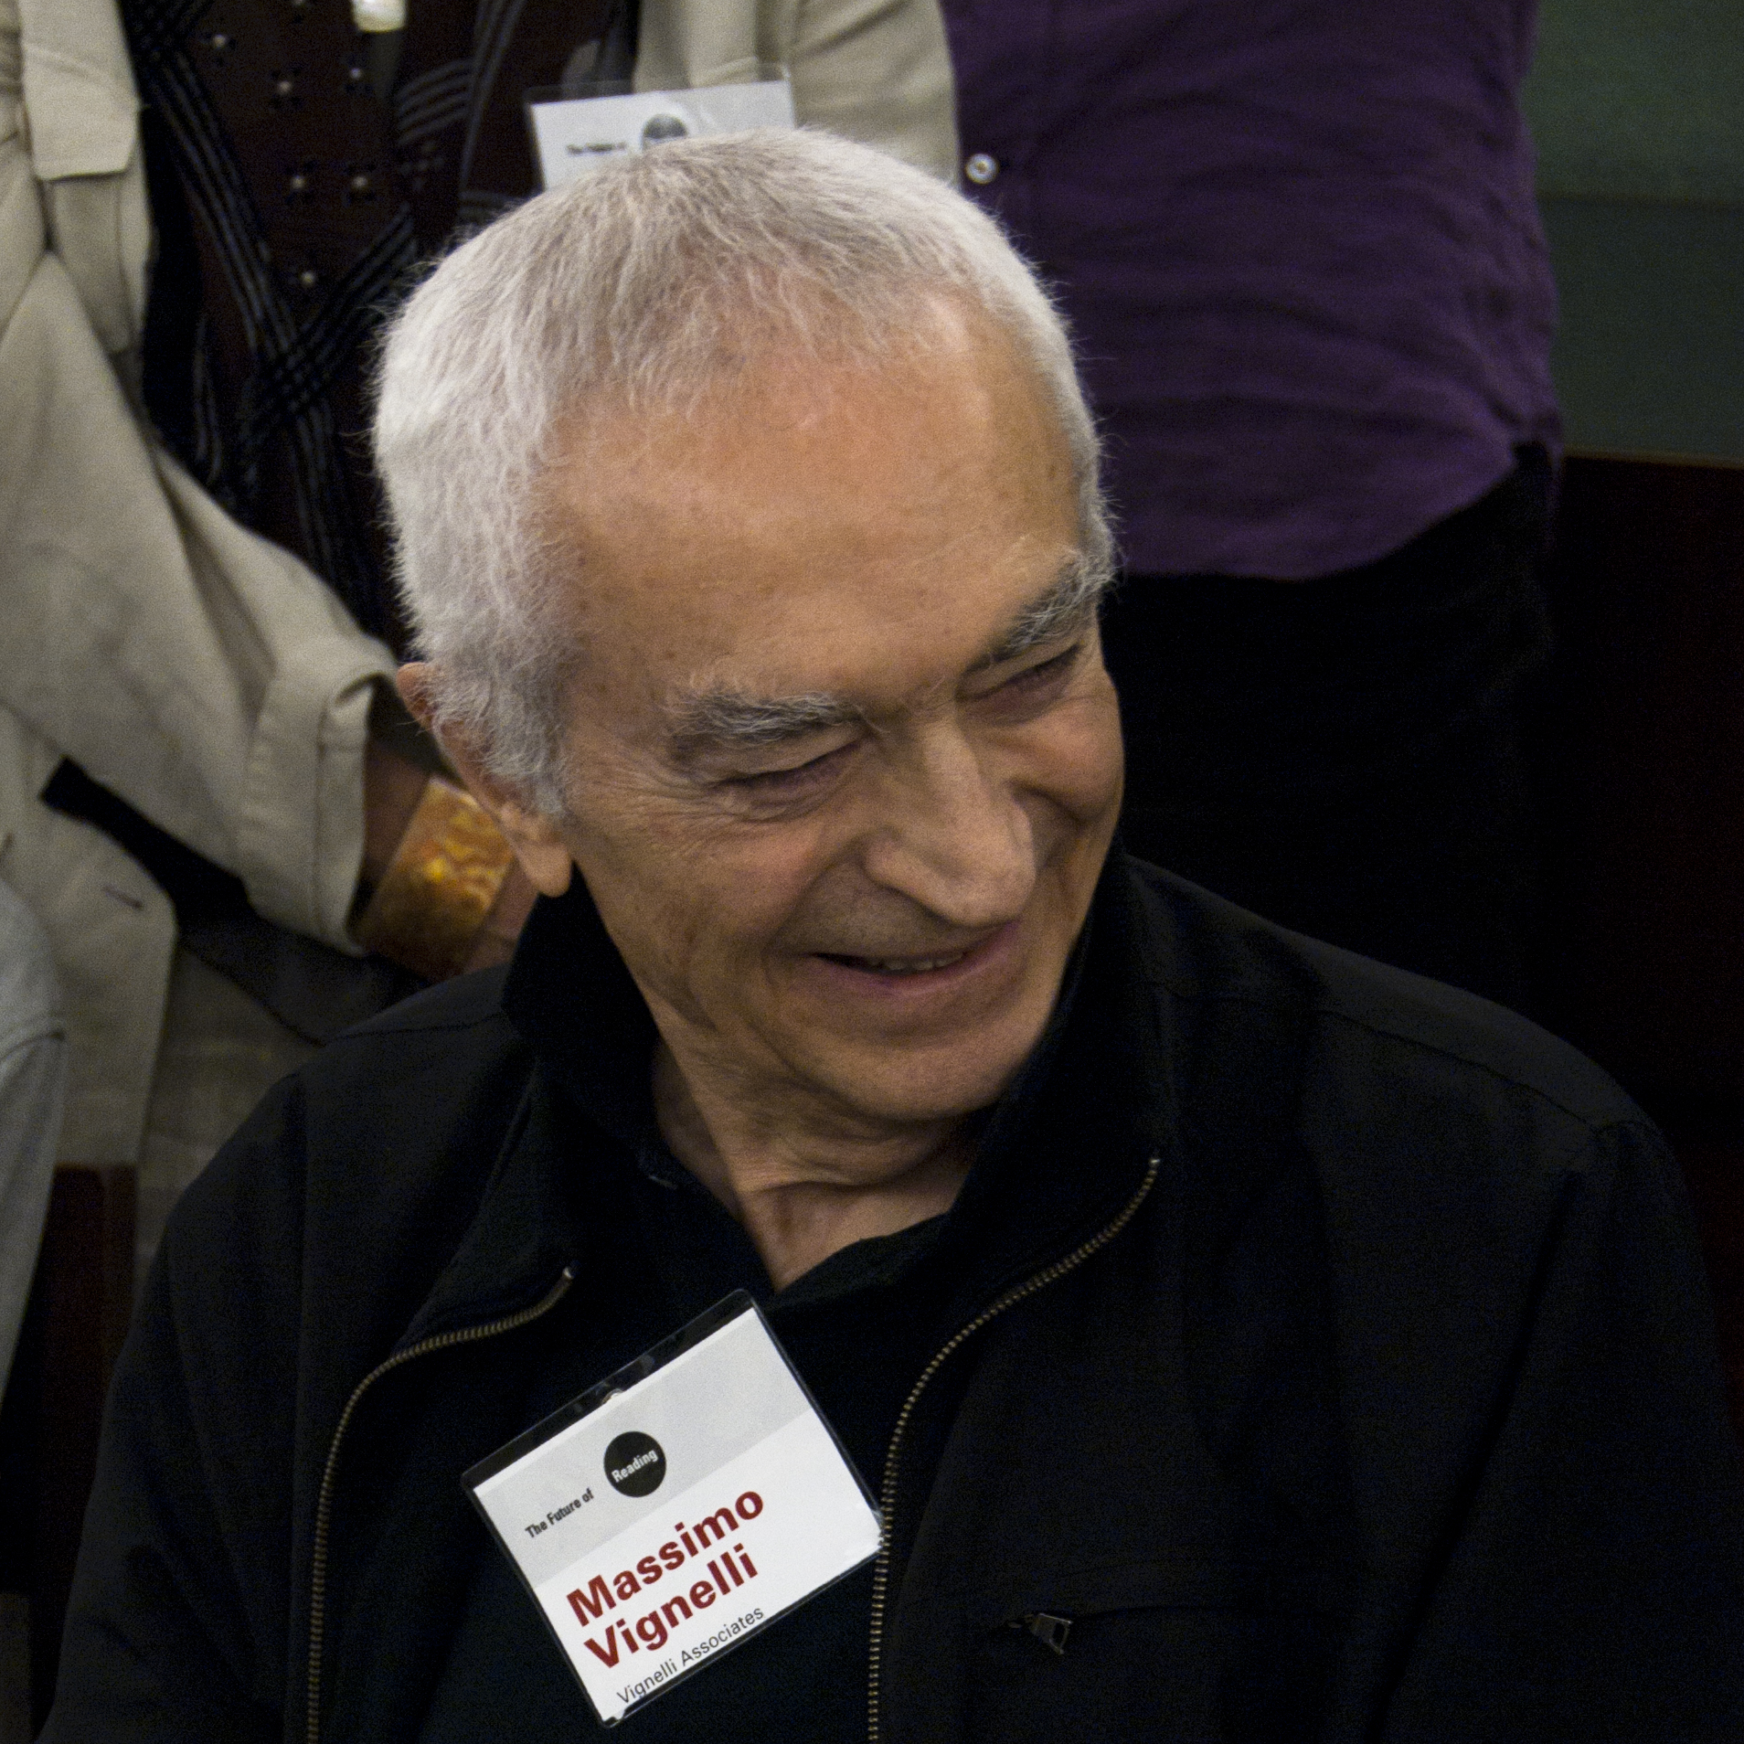
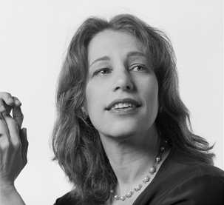
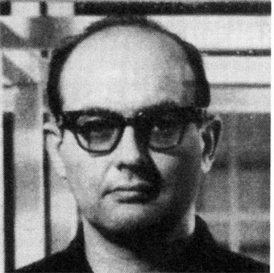
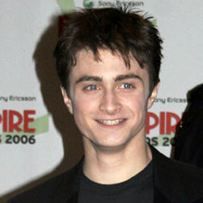
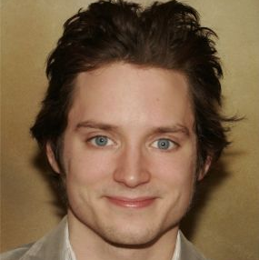
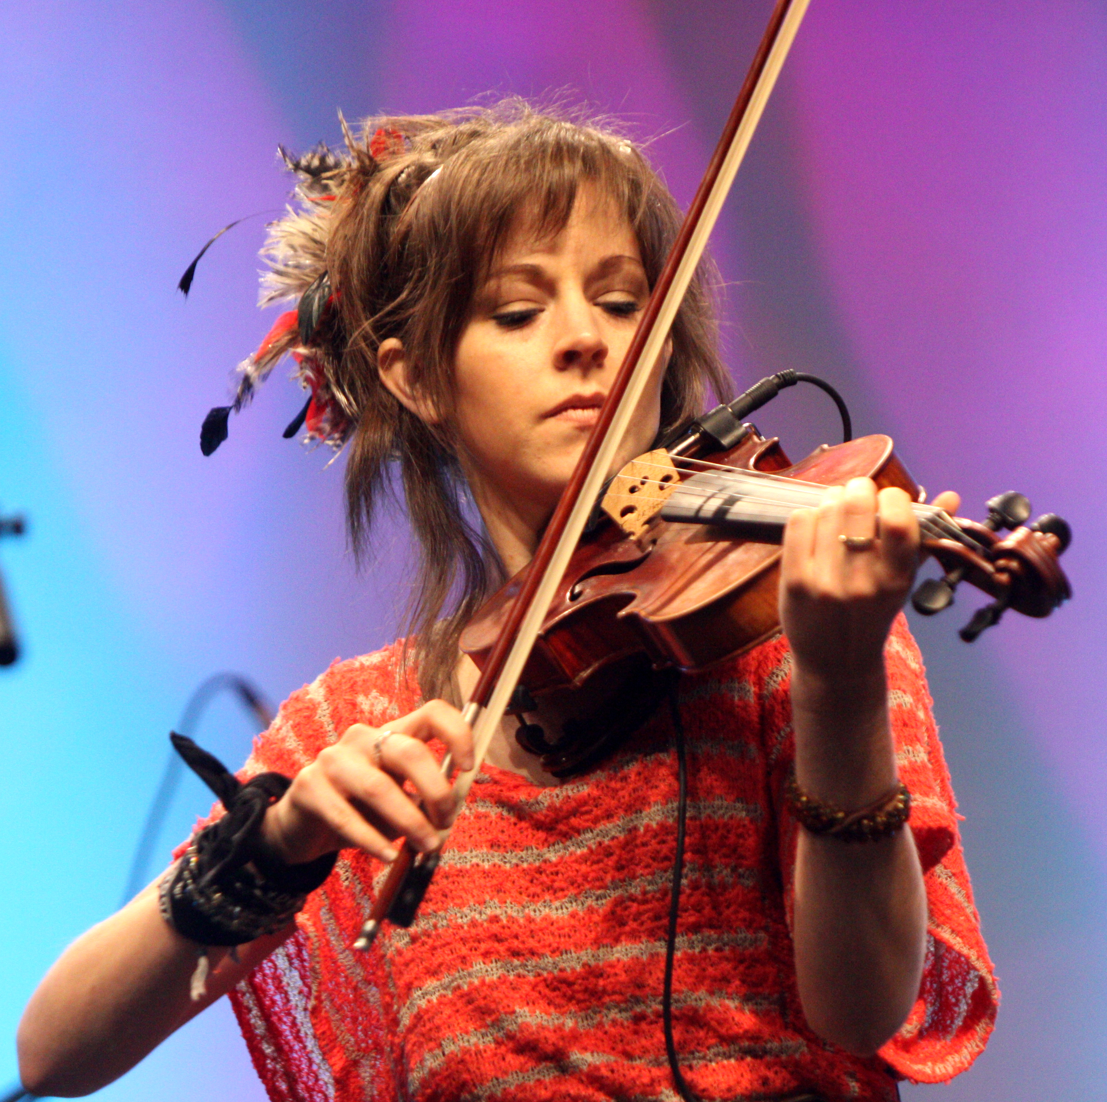
Pick two birthdays
Friends, family or from this list.
Massimo Vignelli 10/01/1931
Susan Kare 05/02/1954
Sol LeWitt 09/09/1928
Daniel Radcliffe 23/07/1989
Elijah Wood 28/01/1981
Lindsey Stirling 21/09/1986

Slide 4
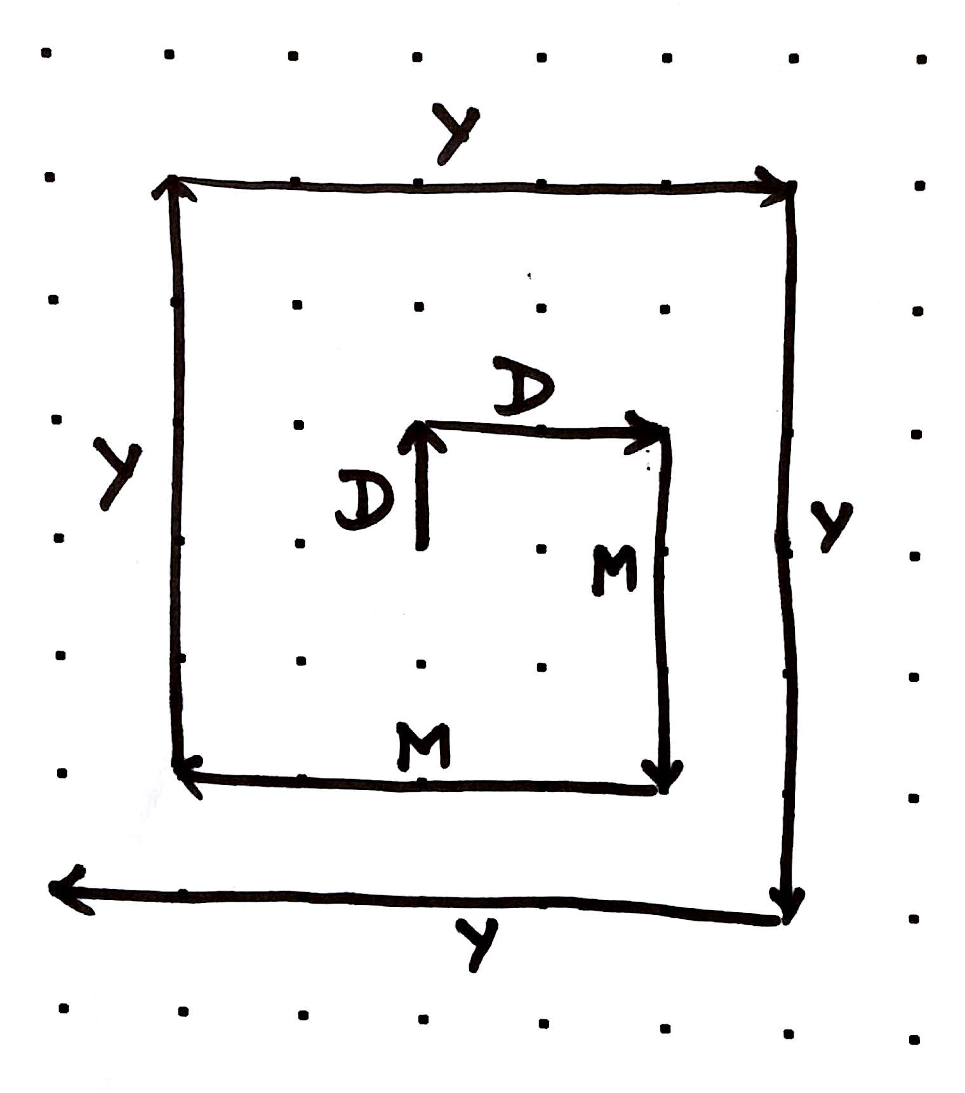
Spiral in!
Move clockwise, starting UP.
For the first digit, move up for that many dots on the grid.
Turn right.
Repeat for all digits.

Slide 5
Symmetry
Move clockwise, starting UP.
For the first digit, move up for that many dots on the grid.
Turn left.
Repeat for all digits.
(Repeat both steps for the second birthday)

Slide 6
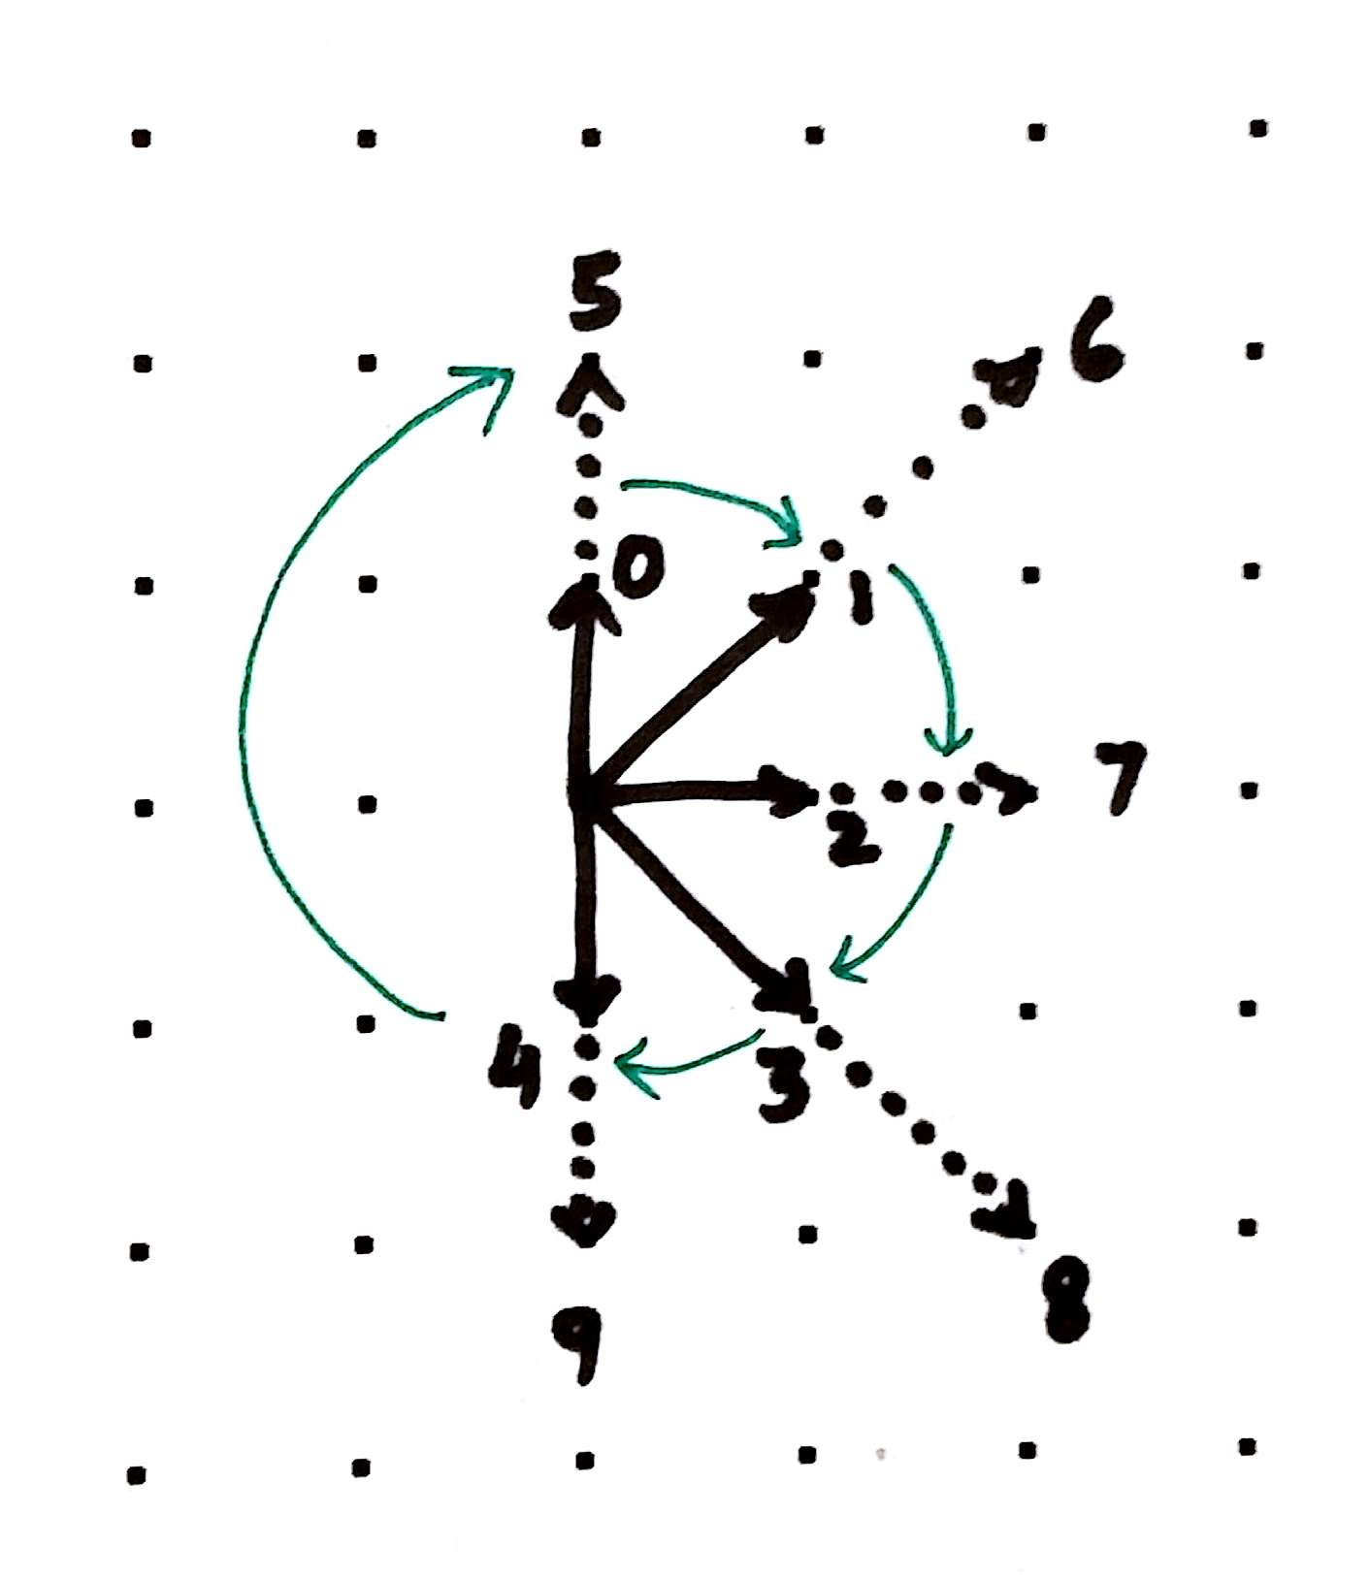
Define an encoding
For each digit, move in the direction & steps as shown.
Continue for each digit.
End by connecting with the starting point.
Repeat to create symmetry

Slide 7
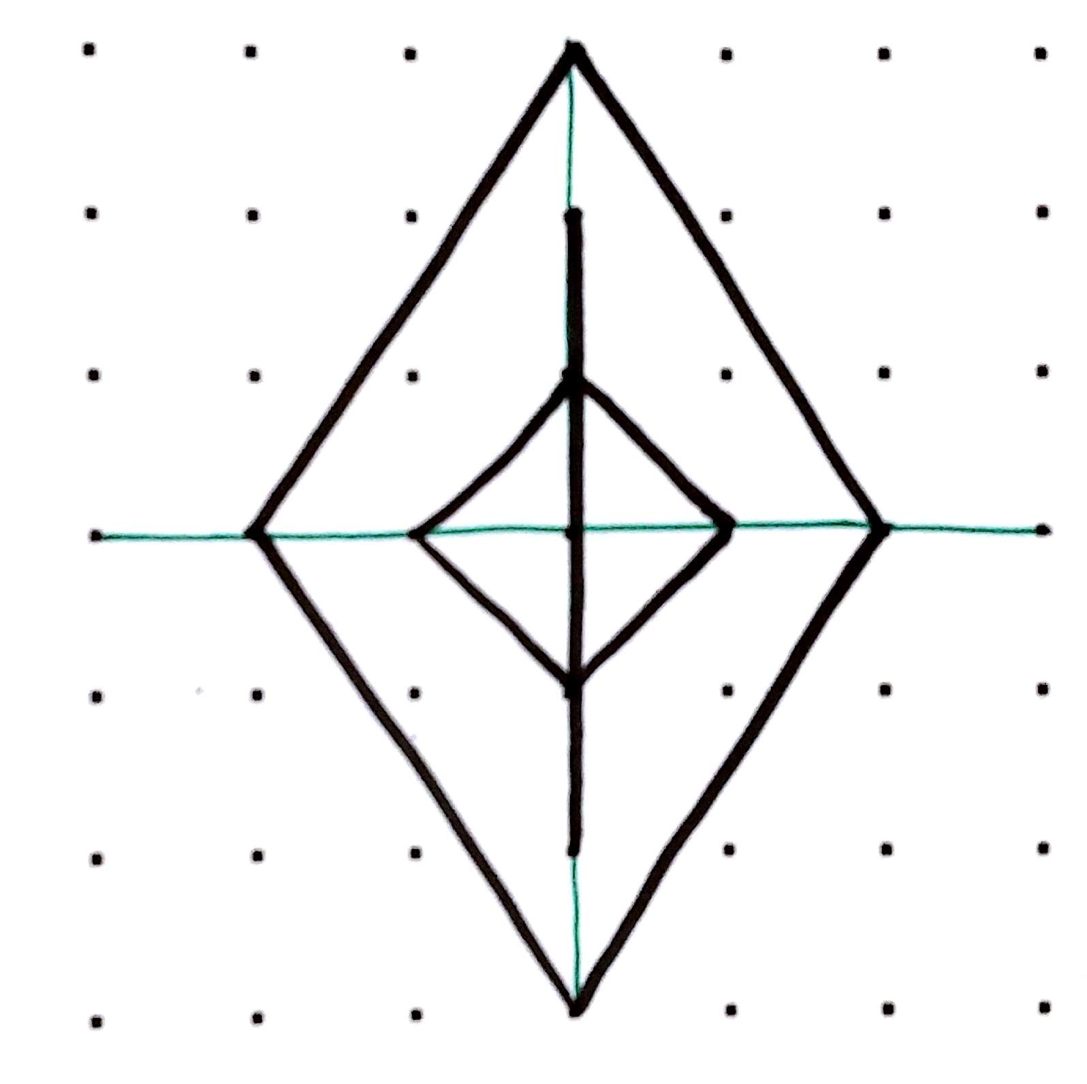
Group your data
Group two-digits as a pair.
Use the first & second digit to define the height & width of the polygon.
Continue for each pair.

Slide 8
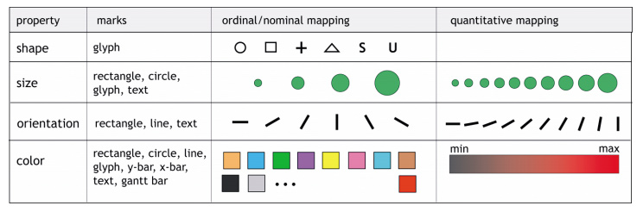
Go crazy!
Data: Convert numbers to binary, roman numerals etc.
Meaning: Convert numbers to text, and use letters for encoding
Encoding: Try shapes, sizes, rotation, color etc.

Slide 9
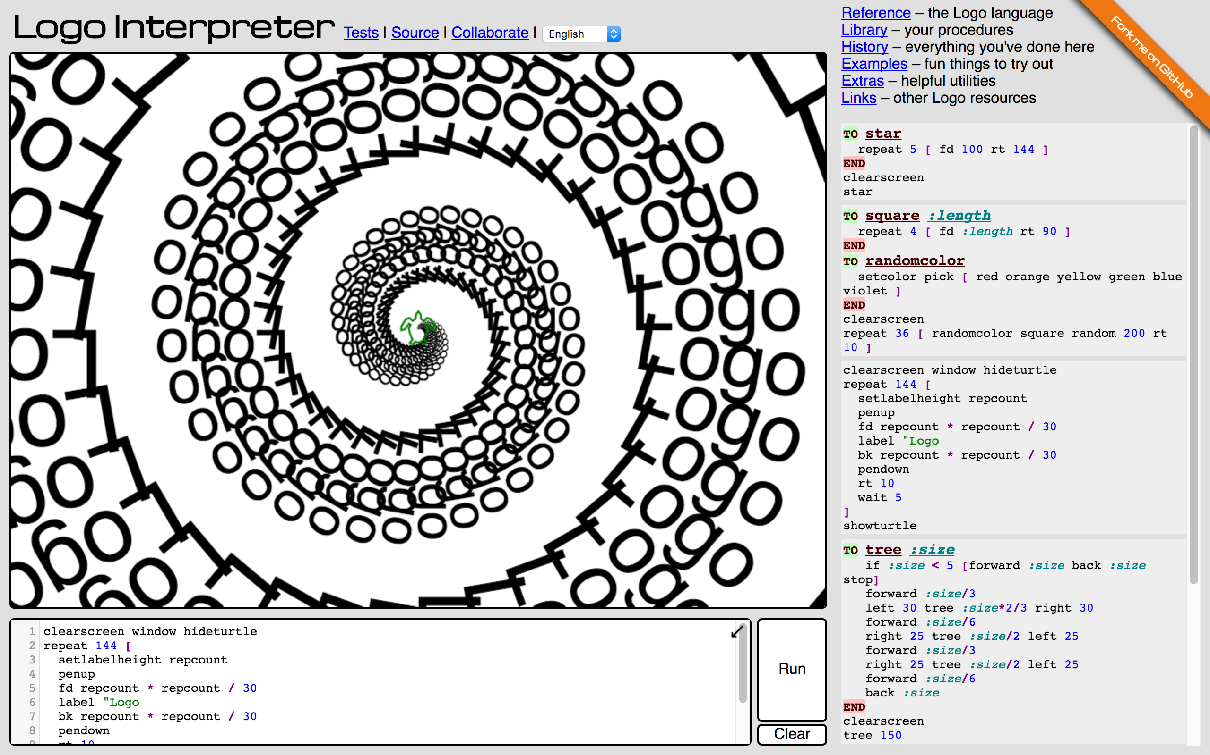
Try this with LOGO
http://www.calormen.com/jslogo/

Slide 10
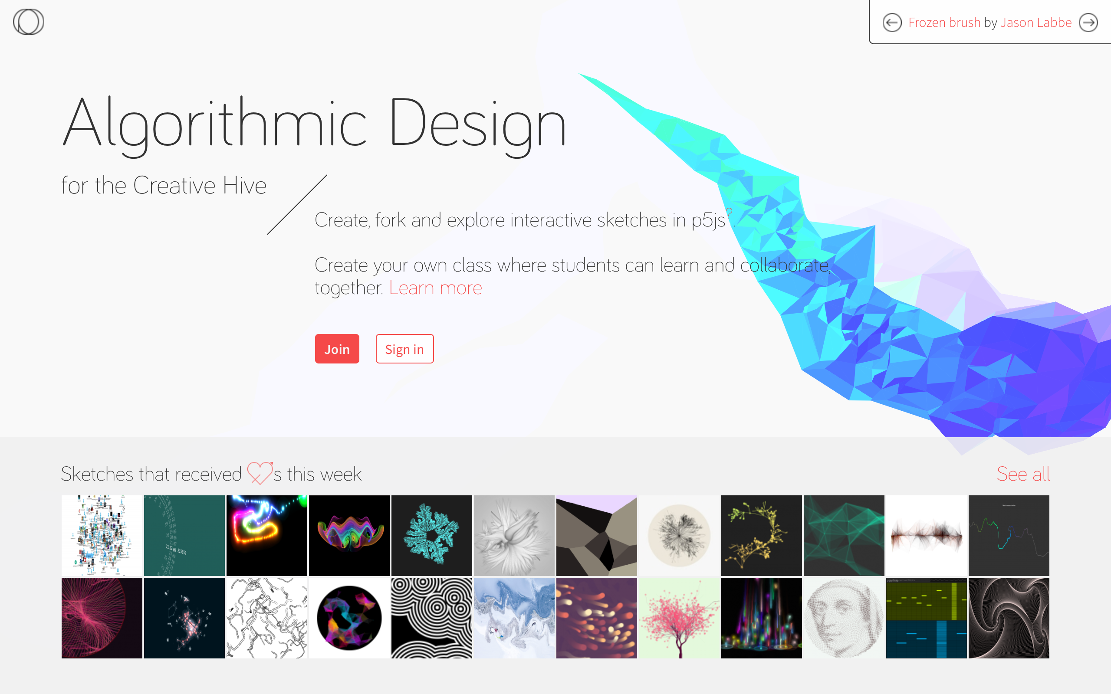
Try this with Processing
https://www.openprocessing.org/

Slide 11
Thanks!
@rasagy

